Slide 1
Basketball
By Lukas Paluch

Slide 2
Basketball
Basketball is one of the most advanced ball games in the world. The most popular basketball league is National Basketball Association (NBA) in USA.

Slide 3
Rules of basketball
Basketball play two teams, each with five players. The task of each team is throw the ball into the opponents basket. Team whitch scored more points at the end of playing time, the winner of the match.

Slide 4
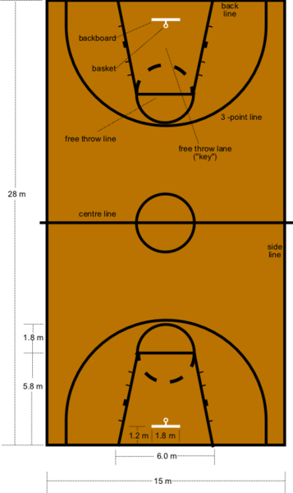
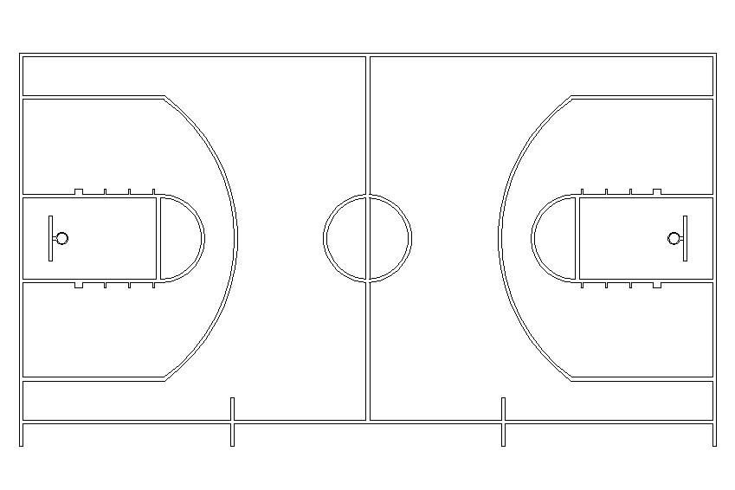
Basketball court
The length of basketball court is 28-30 meters and wide is 14.5-15.5 meters

Slide 5



NBA
It’s one of the most popular and the most most prestigious leagues in the world.
NBA is divided into the Western Conference and Eastern Conference, each of which consists of three divisions of five teams

Slide 6


Slovak Basketball Association
(SBA)
League is played in Slovakia by 10 teams.
Zilina, Nitra, Levice, BB, Inter, Svit, Handlova, Komarno, SNV, Prievidza
Slovak League is very good and popular for Slovak viewers

Slide 7

Academic ZU ZILINA
This is a basketball team where I'm playing.
My position in this team is right wing but I also play like playmaker.
We are two-time Vice-Champion of Slovakia
and we also won some tournaments in abroad (Italy, Ukraine, Czech republic,….)

Slide 8

No pain, no game
This sentence describes basketball
Every player heard this sentence at least one time
My headcoatch tells us this every training

Slide 9
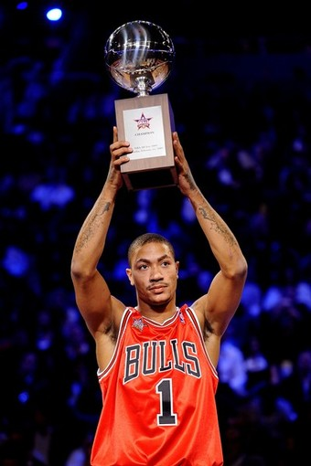

My favorite player
My favorite is Derrick Rose
He is very talented in all directs and he is the most athletic player in NBA
He won the MVP trophy in NBA
He’s playmeker of Chicago Bulls

Slide 10



Dallas Mavericks
Conference Western Conference
Division Southwest Division
Founded 1980
Arena American Airlines Center
City Dallas, Texas
Team colors Royal Blue, Navy blue, Silver, White
Owner(s) Mark Cuban
General manager Donnie Nelson
Head coach Rick Carlisle

Slide 11
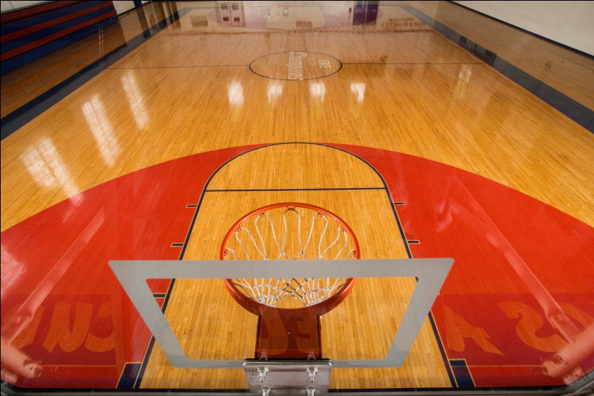
My opinion
My opinion is that basketball is great sport
But basketball hates amateurism because basketball has got a lot of hard rules
A lot of specialist for sport tells that basketball is the hardest ball game
in the world

Slide 12

Unknown words
Advanced- zdokonalený
Basket- kôš
Viewers- diváci
Wing- krídlo
Playmaker- rozohrávač
Headcoatch- tréner
Pain- bolesť
Opinion- názor

Slide 13
Thank you for attention

