Slide 1
Chine

Slide 2
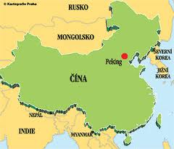
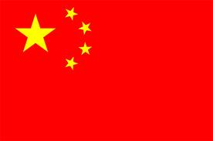
Chine
Area: 9.6 million. km2 Population: 1.3 billion Capital and other major cities: Beijing (Peking), Cunking, Shanghai, Chengdu Government: Republic

Slide 3
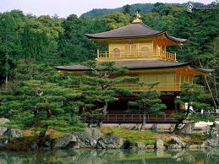
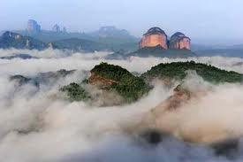
Natural conditions of China:
China is a country with various types of climate. The harsh climate in the mountains, slightly north of the mainland, continental with significant rainfall in the west country. East of the country is often affected by monsoons. South China has a subtropical climate, which is related to the occurrence of cyclones. The average temperature in Beijing in January is - 5.2 degree C and July 25.8 degrees C. Temperatures in northern China in winter to fall to minus 40 degrees C, and similarly in the summer rise above 35 degrees C, which is the typical continental climate in this part of the country.

Slide 4
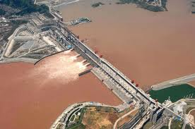
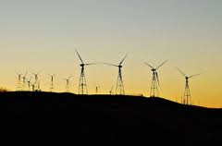
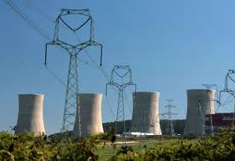
China's economy:
China has vast mineral wealth. Belongs to her first place in the world in production of coal, the mining of tungsten ores.
About 80% of electricity obtained from coal combustion, China. Rest for hydroelectric power.
Other energy derived from nuclear power plants.

Slide 5
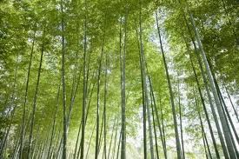
Fauna and Flora of China:
China has a rich fauna and floru.Rastie here more than 7000 species of trees (including 2,800 species of trees), which is a unique example. dawn redwood. Species-rich northeast China with the steppe vegetation of the plains and vegetation of mixed forest and taiga in the mountains. The original flora of South China includes oaks, chestnuts always green, palm, cypress and conifers among rotates. In the southernmost parts of China are small in size preserve tropical rainforests. On the territory of China lives about 2 000 species of vertebrates, which is 10% of global incidence. Through a rich representation of birds, China is called "bird paradise". Prominent position in the Chinese fauna occupies a large panda, a symbol of endangered species. Fauna is threatened by deforestation, alteration of natural living conditions and environment, and also traditional Chinese culture, in which some animals are considered an aphrodisiac.

Slide 6
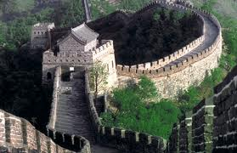
Population and culture of China:
Peoples Republic of China is a socialist republic, composed of twenty-two provinces, five autonomous regions and five special economic zones. Communist rule and has only a formal multi-party system. Head of state is the president, the prime minister is the prime minister. The capital is Beijing. On the area of ​​9 561 000 km2 lives in China nearly 1.25 billion people. More than 93% of the population is nationality Chan, except they can be distinguished from dozens of other nationalities and ethnic groups.

Slide 7
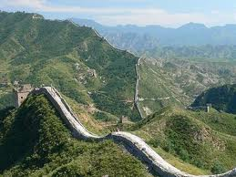
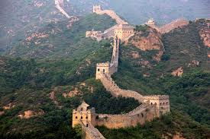
Chinese wall
It was built in the Ming Dynasty in the period from the late 15th in the early 17th century century.

Slide 8
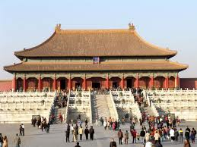
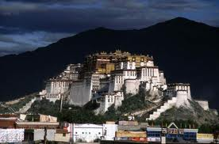
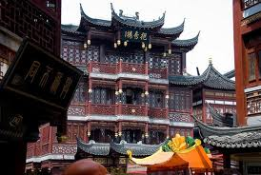
Chinese palace

Slide 9
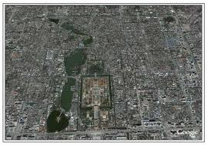
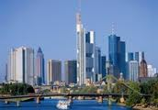
Capital of China
Beijing
has 17 million residents

Slide 10
Thank you
Author:David Pijak

