Slide 1
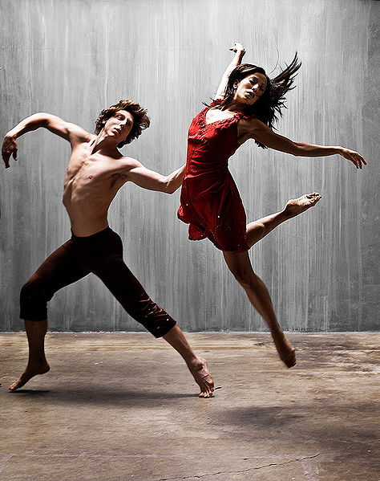
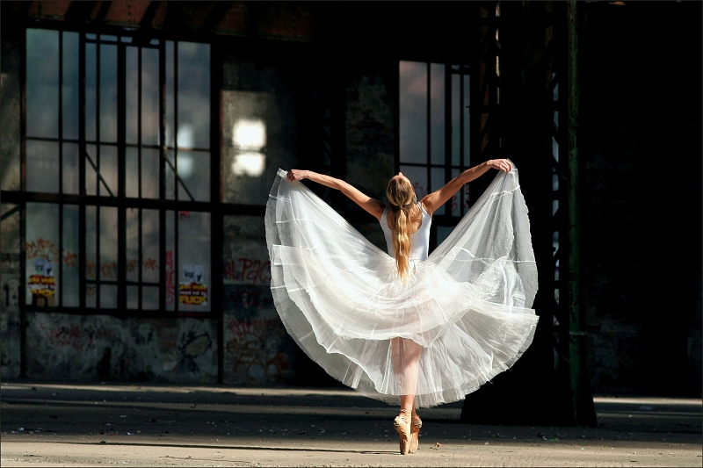
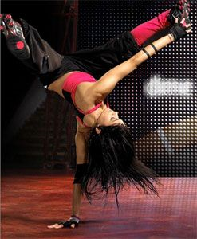
Dance
Betka Ďurčová

Slide 2
What is dance ?
Dance is an art form that generally refers to movement of the body, usually rhythmic and to music.
Dance may also be regarded as a form of nonverbal communication between humans, and is also performed by other animals . For example bee dance ☺

Slide 3
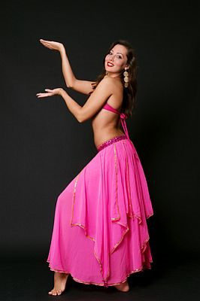
Dance can embody or express ideas, emotions or tell a story.
Dancing evolved many styles.

Slide 4
The basic division dance:
1.religious dance
2. folk dance
3. ballroom dancing
4. standard dance
5. salsa
6. ballet
7. figure skating

Slide 5
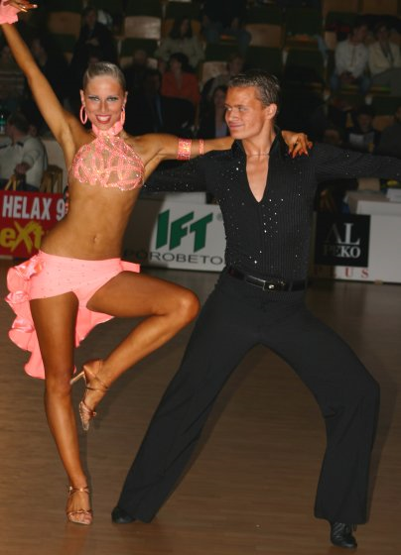
SALSA
Salsa is a social dance originatLatin dances include: Cha , rumba, samba, salsa, mambo, merengue, bachata, Kumba, bolero.ing in Latin America.

Slide 6
According to the number of dancers:
dance pair
solo dance
belly dance
Breakdance
Step
Ballet
Hip hop

Slide 7
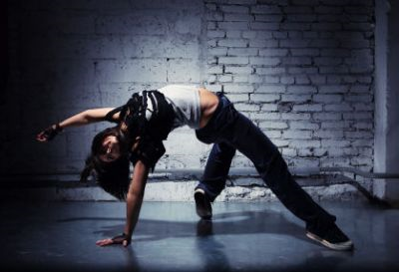
Hip hop
hip hop originated in New York (USA) in the 70 the 20th century in neighborhoods populated mostly black population. Over the years, evolved into its present form - a global urban youth subcultures.

Slide 8
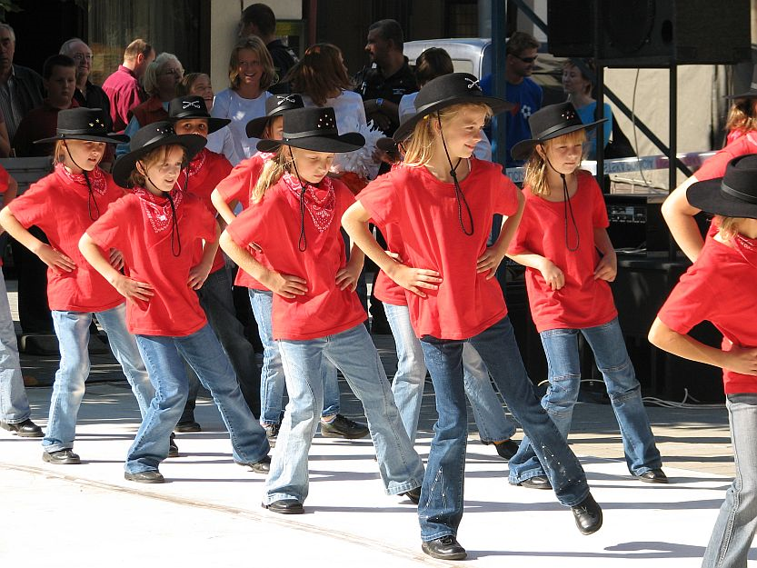
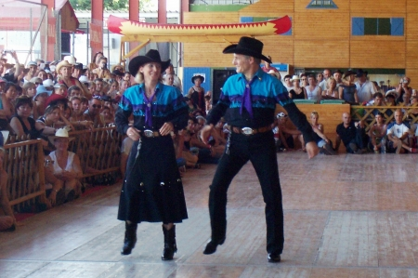
Group dance
Country dance
Cancan
COUNTRY DANCE
This style has its own rich history and danced in several forms throughout the world. There are many lovers of this style and this úžastnej country music. Historical country are dances from the Middle Ages. Its time to dance at a higher privileged society.

Slide 9
By period
Gothic Bellydance
Baroque dance
Renaissance dance
modern dance

Slide 10
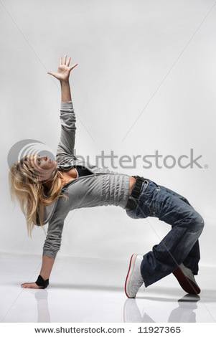
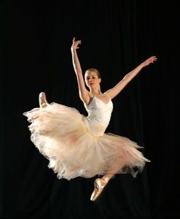
Modern dance
Modern dance, as we know it today appeared after the First World War.

Slide 11
According to the origin
African Dance
Indian dance
Dances Australian aborigines
South American dance

Slide 12
ďakujem za pozornosť ☺

