Slide 1
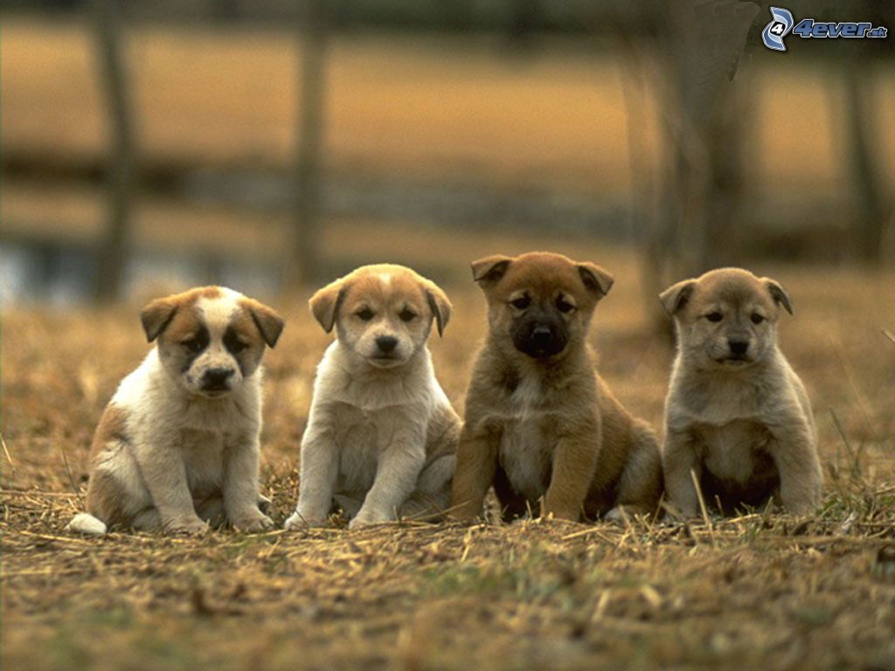
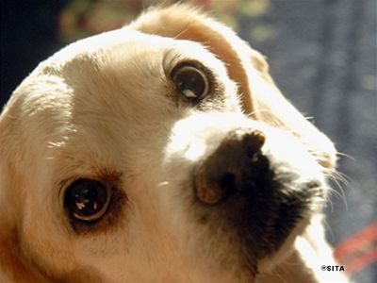
Dogs
Ivana Vnuková

Slide 2
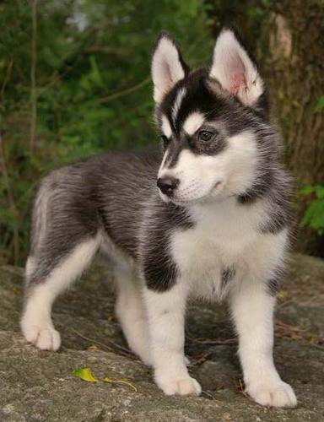
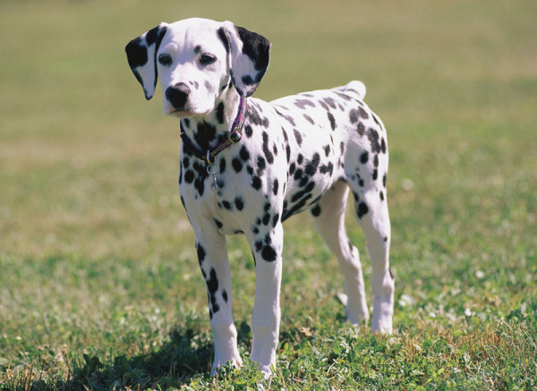
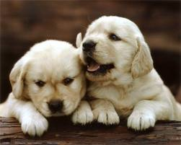
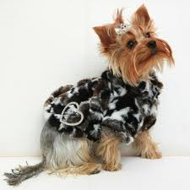
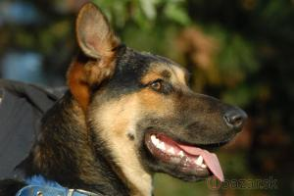
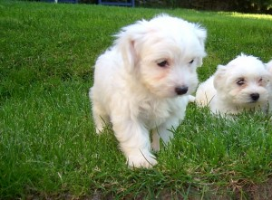
Dog breeds

Slide 3
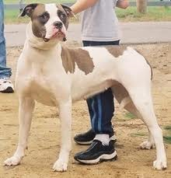
Alapaz full-breed bulldog
This breed is recognized in United States.
Is it muscular and strong breed. His weight is 30 – 45 kilograms, and his height is 48 – 66 centimeters.Their typical colors are white, shades black,red,gray,brown.

Slide 4
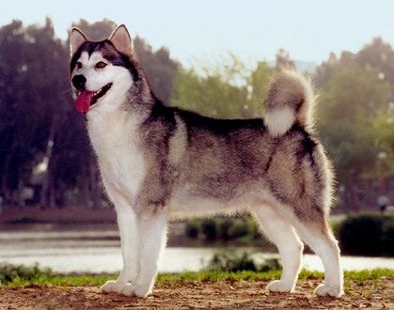
Alaskan Malamute
Is it dog breed, coming from USA. They belong to oldest breed sledge dogs. Usually they live in northwest Alaska. They emenative strong,elegance and reverence. They are bold, no tremulous or aggressive.

Slide 5
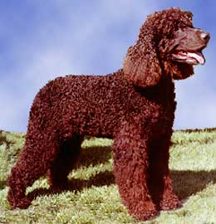
American Water Spaniel
He coming from state Wisconsin. Pedagogy and discipline aren’t doubtable. He likes children.

Slide 6
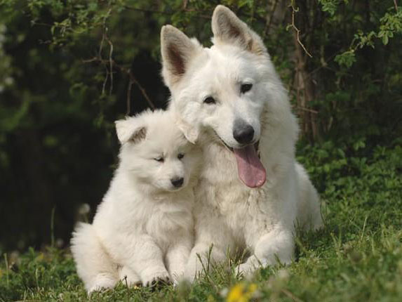
White swiss shepherd
This dog coming from Switzerland. His avarage length of life is 12-13 years. They are similar of german shepherd. They are friendly and nice to their family.

Slide 7
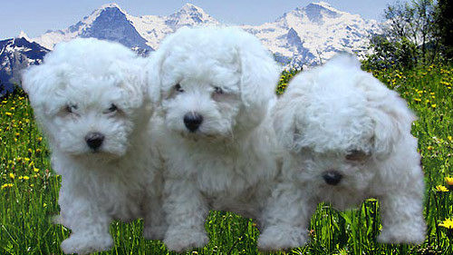
Bichon
He coming from France and Belgium. Is it playful and happy breed , that has got curly, soft, white coat. He need regularly softener eyes.

Slide 8
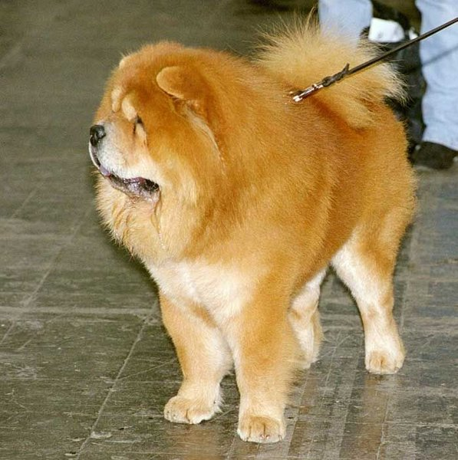
Chow-chow
This breed coming from China. We can say, that he is stubborn and independent, dedicated, sweet. Is suitably to city and village. This breed hate penalties and he will never listen to the word.

Slide 9
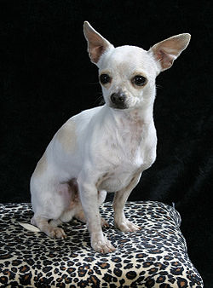
Chihuahua
Breed coming from Mexico. Chihuahua is smallest dog from all breed. Are two tips this breed. Is it longcoat and shortcoat. Is high about 20 centimeters.

Slide 10
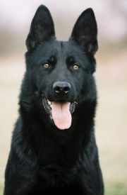
German shepherd
Is excellent friend. To unknown people is skeptic. He is playful. People used this breed in police services.

Slide 11
Thank you.........☺

