Slide 1
Slovak Football
Ján,,BOB,,MAcúš
Erik,,kocko,,KOcúr

Slide 2
Slovak Football Association
Slovak Football Association (SFA) was founded in 1938. It is the largest organization in Slovakia with more than 400 000 members. SFA ensures regular sporting activity of more than thousands of tens of young people within its structure. It is held about 5,000 matches every week in the towns and villages across the whole country.

Slide 3
History SFA
The first mention of organized football in our area comes from 1893. An important milestone in its development was the emergence of the Czechoslovak Republic. The conditions for sports development were created and the basics for the organization of football in Slovakia were established. The first Slovak football club was 1. Čs. ŠK Bratislava based in 1919. Massive expansion of football began in the postwar period. Significant increase in the number of players, teams, and especially in youth categories may be observed in mentioned period.

Slide 4
Achievements
Czecho-Slovak football:
- 2nd place (silver) on the World Cup in 1934 in Italy - 2nd place (silver) on the World Cup in 1962 in Chile - 1st place (gold) on the Olympics in 1980 in Moscow - 2nd place (silver) on the Olympics in 1964 in Tokyo. - 3rd place (bronze) on the European Championship in 1960 in France - 3rd place (bronze) on the European Championship in 1980 in Italy - 1st place (gold) on the European Championship in 1976 in Yugoslavia
Slovak football:
- last 16 2010 FIFA World Cup in South Africa

Slide 5
Facts
All players
Registered players
Un-registered players
Clubs
Officials
622 668
428 968
193 700
2 432
18 773

Slide 6
League
Corgon league
Slovak Cup
1. league
2. league (west)
2. league (east)
3. league
4. league
5. league
First class
Second class

Slide 7
Corgon league
League is the highest Slovak football league. Years 1993/94 to 2002/03 was called Mars Super League. 12 teams played with every system every 3 matches. Each team has 16 games then perform an outdoor and 17 games at home or vice versa. At the end of season one with the final placed in the table falls into the 1st league.

Slide 8
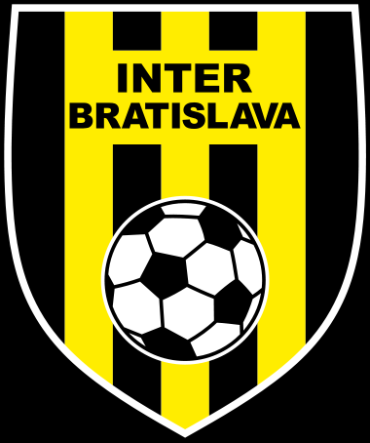
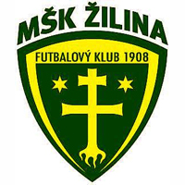
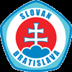
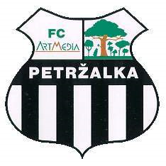
The winners of the Corgon League
Year 1993 from the Premier League champions build enlarge The same clubs. MSK Zilina 5x became champion, was champion Inter Bratislava 2, FC Artmedia was champion 2 FC 2 FC were champions, the champions MFK Ruzomberok 1, Slovan Bratislava Champion 5x the current season and is close to acquire other trophies.

Slide 9
Slovak National Team
Slovak national football team is the national team, which represents Slovakia in international football events, for example. World Cup or European Championships and in international matches. Slovakia's national team took place during the years 1939 to 1944 16 games, then after World War II was part of the Czechoslovak national team. His first official match took place against Slovakia United Arab Emirates on 2 February 1994. Won 1-0. Goal scored in 47 minute of the match Vladimir Weiss sn., who later became the Slovak national team coach

Slide 10
Slovensky futbalovy tim v Afrike
Horna rada z ľava: Vittek, Škrteľ, Šesták, Mucha, Pekarík, Kaplik, Štrba
Dolna rada z ľava: Sapara, Weiss, Zabavník , Stoch

Slide 11
MSK Zilina
In September 1928 after winning the triple champion of Slovakia I. ČsŠK Bratislava and Bratislava SC Ligeti received SK Zilina football first pride Slovak Championship was finally broken and the four best teams of CSR, ie the semi-final amateur championships.
The valuable achievements should be included also Arieh team victory in the national competition for the Cup of the Slovak National Uprising in 1961 and advance to the finals Cs. Cup.

Slide 12
Thank you for attention

