Slide 1

Music
by
Gardenier

Slide 2
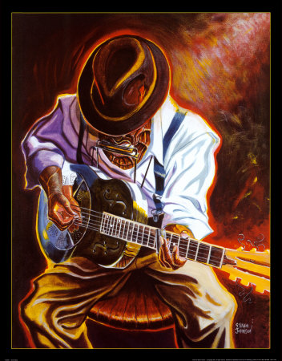
Blues
Blues is a vocal-instrumental form of music which has origin in African American communities in southern U.S.
Solo voice was later accompanied by musical instruments, very often by the guitar and harmonica
The word "blues" refers to the fact that a person is under the influence of demons of grief

Slide 3
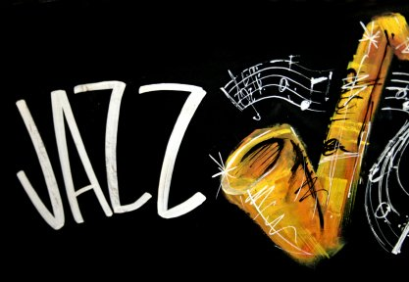
Jazz
Jazz is music genre that originated in early 20th century in the USA, in New Orleans, which is located in Louisiana. Created by the gradual merger of the African-American folklore with European musical traditions
Style is characterized by improvisation, in a special way of engaging tone and metro rhythmic several zones. Jazz meant revolutionized popular music of the 20 century.

Slide 4
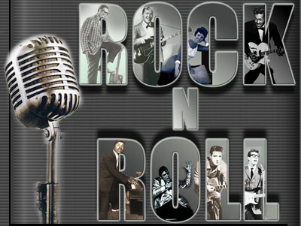
Rock 'n' roll
Rock and roll is a genre of popular music, which originated and developed in the United States during late 1940 and early 1950 mainly from a combination of blues, country, jazz
Classic rock and roll is usually played with one or two electric guitars (one lead, one rhythm), a string bass or (after the mid-1950s) an electric bass guitar, and a drum kit

Slide 5

Rock
Rock music is a genre of popular music that developed during 1950 and after 1960, particularly in the United Kingdom and the United States
Rock music is centered around electric guitar, usually as part of a rock band with bass guitar and drums.
A lot of musical styles was derived from rock

Slide 6

Punk
rock
Punk as a movement built gradually, although in its origin resides usually referred to year 1976
Especially in England, this style was seen only as a matter of music, but also as a matter of lifestyle

Slide 7
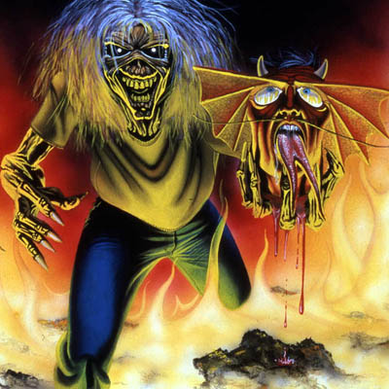
Heavy metal
Heavy metal is a type of rock music, which is defined as a style of music emerged at the turn of the 60th and 70 years in the United Kingdom and the United States
Has roots in hard rock bands, combining the blues and rock and created a new musical style, characterized by the use of electric guitars and drums, and also loud and distorted sound
Ever since its inception had a big heavy metal fan base, who are known as metalheads

Slide 8

Reggae
Reggae is a music genre that originated in Jamaica in the 60 past century
Although sometimes used to refer to a broader range of Jamaican music, reggae word originally designated a clearly polarized style of music
Interprets - Peter Tosh, The Wailers, Max Romeo, and more...

Slide 9

Grunge
Grunge (sometimes called Seattle sound) is based on music genre: alternative rock, to a certain degree of rock'n'roll, punk, from which it takes only the melody and rhythm and is taking heavy metal guitar elements
In Utero Album of 1993 from Nirvana is considered by someone as the last grunge album, but many bands that promote this style, long after grunge albums recorded
This genre of music comes from Portland and Seattle

Slide 10

Ska
Ska is a music genre that evolved in the late fifties in Jamaica and is considered a forerunner of Rocksteady and Reggae music. It has a typical fluctuating rhythm is faster than reggae and often mixed with punk and jazz
Music producer is trying to spread it around the world in what way have the full support of government and in 1964 was declared a national ska Jamaican music

Slide 11
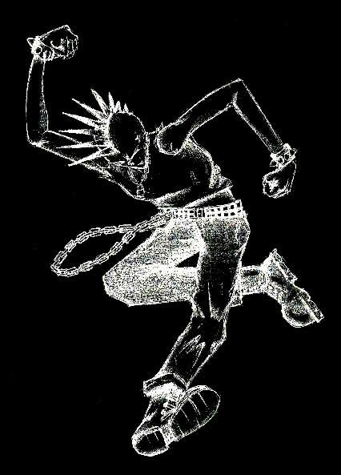
Pogo
Pogo is a kind of punk dance
Dance originated in the United Kingdom in the mid seventies of the 20th century. For the first time he appeared in concerts punk group The Vibrators, Sex Pistols and The Clash in the clubs, whose capacity was not sufficient for the number of participants shows.
When dancing pogo is primarily about hopping to the beat of punk music, which is accompanied by pushing the surrounding dancers of pogo by hands

Slide 12

Thank
you
for
watching

