Slide 1
My favourite books
Katarína Kováčová

Slide 2
Books
My favourite activity is reading. I read everytime: at school, outdoors and home.

Slide 3
My favourite books
This is my favourite books
1. Dan Brown: The Lost symbol
2. Tess Gerritsen: The Keepsake
3. Dan Brown: Angel And Demons

Slide 4
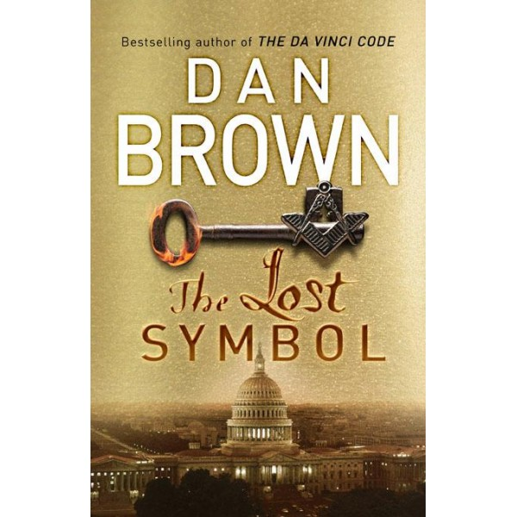
Dan Brown: The Lost symbol
This is the best book! I read books from Dan Brown a long of time and I think it is the best.
Book is about Robert Langdon and Masonic mystery.

Slide 5
Advantages
Book is exciting and interesting. I cant stop read it.
The character is cool
In the book is a lot of informations about history

Slide 6
Disadvantages
Chapters is divided bad for me, because something start and chapter is finish

Slide 7
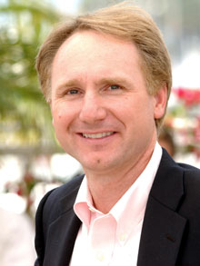
Dan Brown
Author of the novels Da Vinci Code, The Lost symbol, Angel And Demons.
He writes the best books and he is popular in literary world
He lives in USA.

Slide 8
Tess Gerritsen: The Keepsake
Well-construced story from world crime. It is about mummy and cold case

Slide 9
Advantages
It is interesting and character is cool too.

Slide 10
Disadvantages
Real story begins on 80 page!!

Slide 11
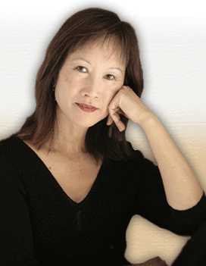
Tess Gerritsen
She is a writer of criminal novels. She was born on 12 June 1953 in California.
She writers medical thrillers and romantic suspense.

Slide 12
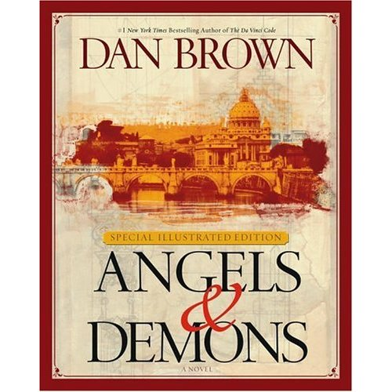
Angel and Demons
The book is about Robert Langdon.
Story goes in Vatican and it is about confidential legends.

Slide 13
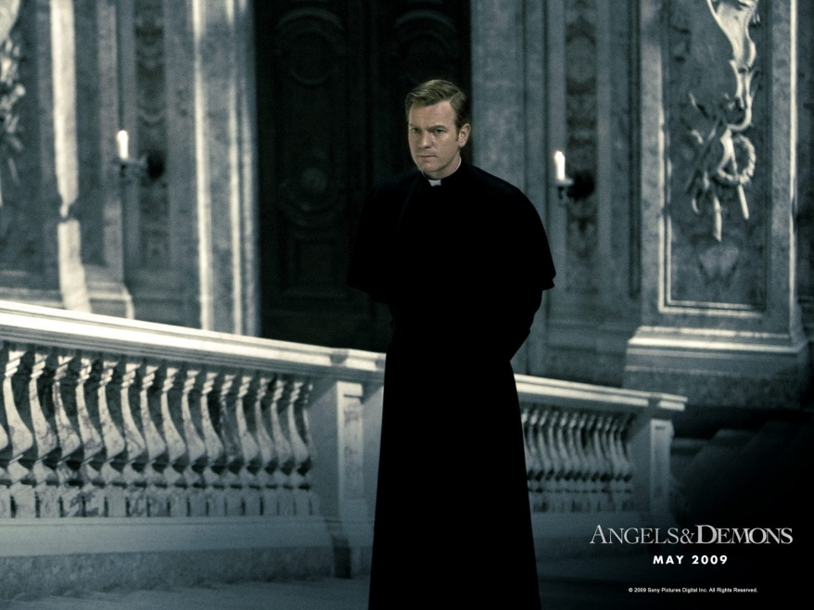
Advantages and Disadvantages
I love this book and I don't know about disadvantages.

Slide 14
