Slide 1
My favorite dog
Barbora Drndová

Slide 2
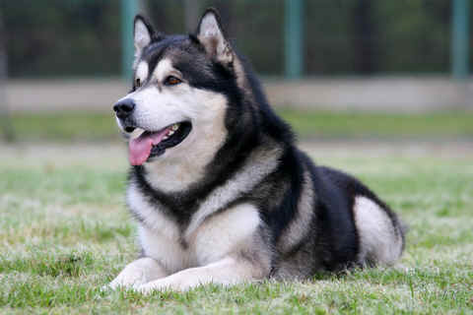
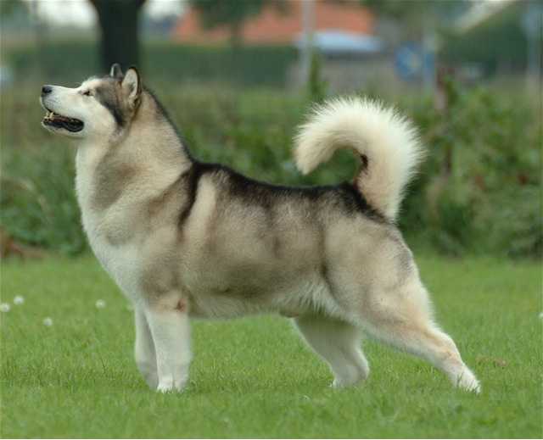
Alaskan Malamute
Original name of the breed: Alaskan Malamute
Country of Origin: USA
Time of: Ancient
Original use: Sledge dog, hunter
Today's use: companion, sledge dog, companion for sports
Life expectancy: 12 years
Weight: Dogs 39-40 kg Female 29-30 kg
Height: Male Female 63.5 cm 58.4 cm

Slide 3
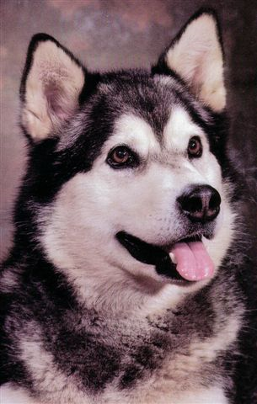
Alaskan Malamute
The Alaskan Malamute is a generally large, wolf-like breed of domestic dog (Canis lupus familiaris) originally bred for use as an Alaskan sled dog. They are sometimes mistaken for a Siberian Husky, but in fact are quite different in many ways. As pets, Malamutes have a very quiet temperament and are often loyal to their owners.

Slide 4
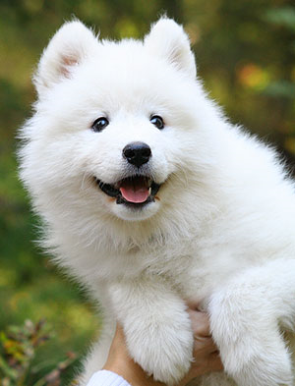
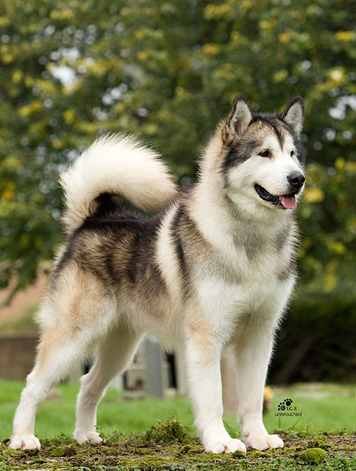
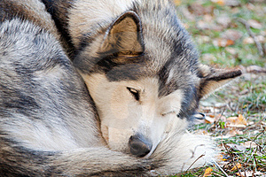
Alaskan Malamute dog breed is derived from the U.S. recognized by the FCI under Section 5 243rd One of the oldest breeds of sledge dogs, which include eg. Siberian Husky and Samoyed

Slide 5
Appearance
Malamute should have harmonious physique and give the impression of force, elegance and dignity. Malamute coat may be discolored from light gray to black or from gold through various shades of red to brownish red always with white markings. The only allowed one color coat color is white

Slide 6
Nature
To be courageous, healthy wonder in no way shy or aggressive. Well socialized Malamute is cheerful companion, loves children and other dogs. Although that is friendly and affectionate, it retains a certain amount of independence and autonomy.

Slide 7
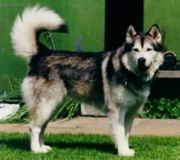
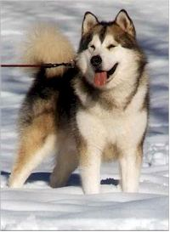
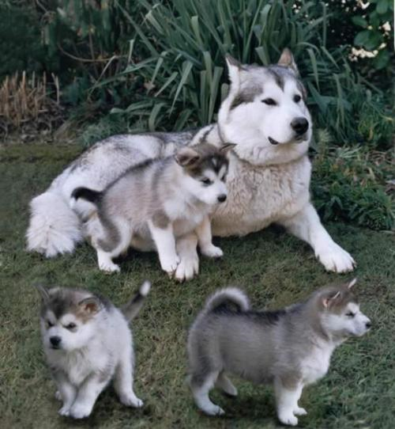
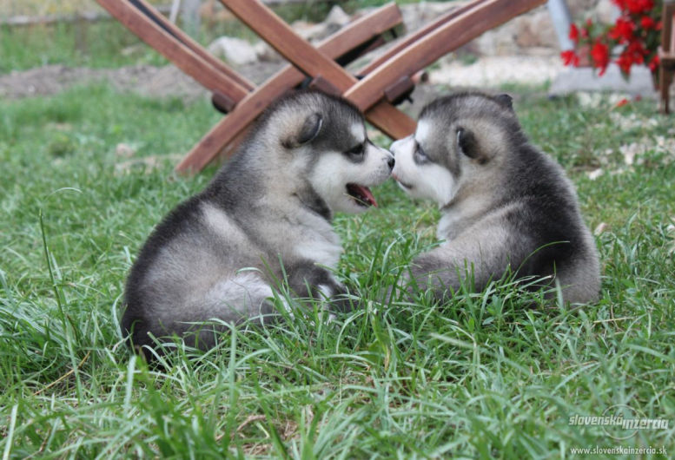
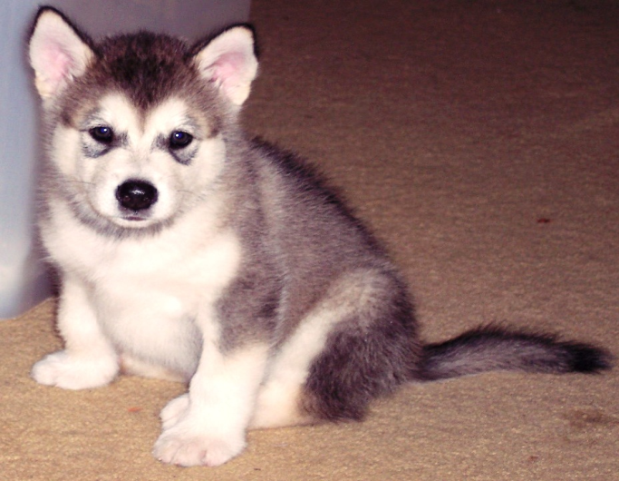
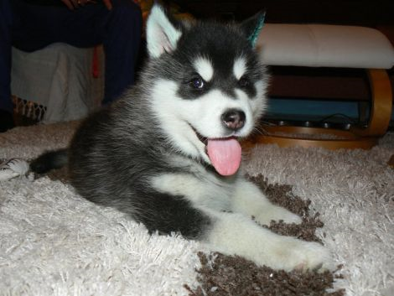
Alaskan Malamute

Slide 8
MOVEMENT
Movement is probably the most important part of education Alaskan Malamute. This dog is needed, too much movement.

Slide 9
Finally
Malamute as every dog has its positive and negative aspects. Living with him is not only a joy. Who is impressed with its attractive appearance and wants him only as "gypsum dwarf" in the gardens, will be surprised when, as the garden goes.

Slide 10
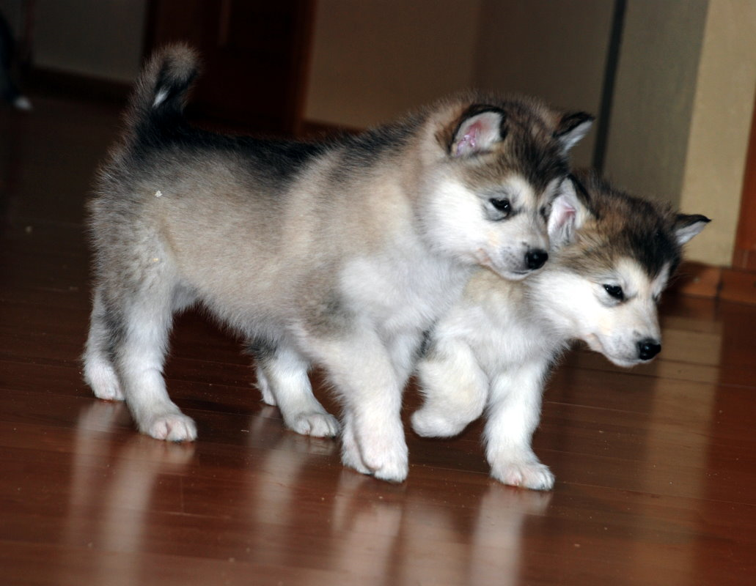
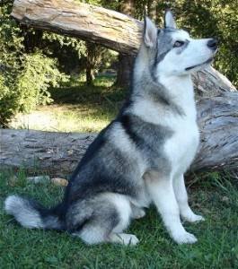
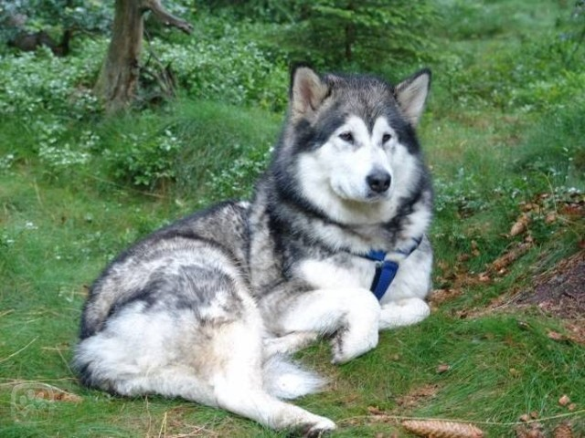
Thank you for your attention

