Slide 1
Food
Beáta Záhradníková

Slide 2
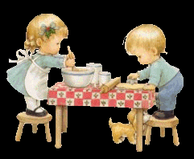
Food
Food is a source of energy, nutrition for animals and humans.
We would die without food.
Food is healthy or unhealthy.
People often eat unhealthily.

Slide 3
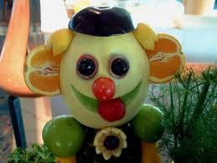
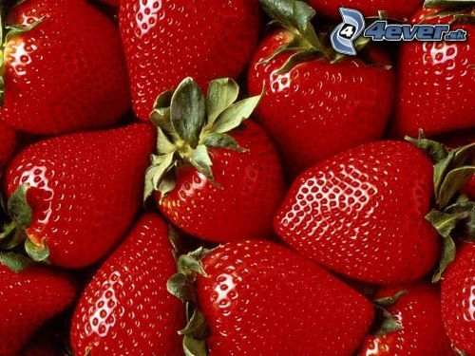
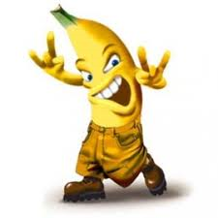
Healthy food
It is a diet that is high volume and low energy.
We should have breakfast, lunch, dinner, snack, dinner.
We shouldn´t skip soups and eat late evening.
This is: fruits, vegetables, meat, milk products, cereals, ...

Slide 4
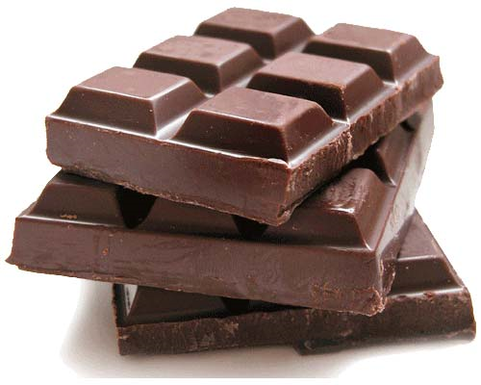
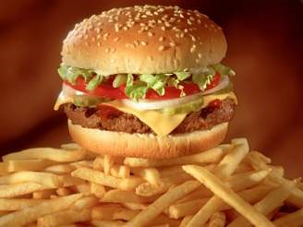
Unhealthy food
This includes mainly fatty foods.
They are also food which contains many E.
This is: chocolade, chips, hamburger, fried meat, pizza,...
These meals are also called calorie bomb.

Slide 5
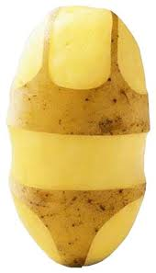
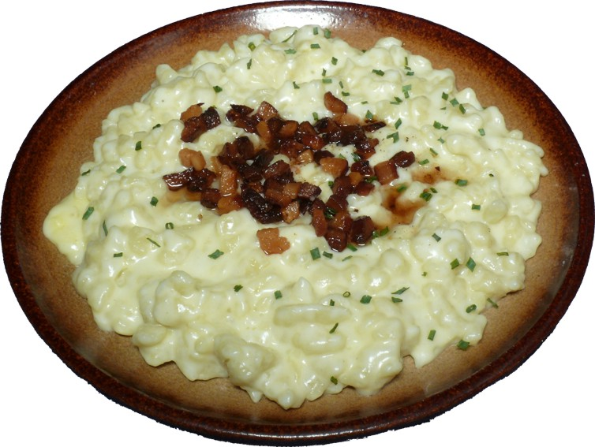
Slovakian food
Slovakia food: pork, lamb, flour, potatoes, cabbage and milk products,...
One of the Slovak national foods are sheep cheese dumplings, which were use to prepare the sheep cheese, smoked bacon, potatoes and flour.
I love Slovakia food.

Slide 6
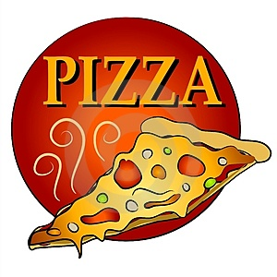
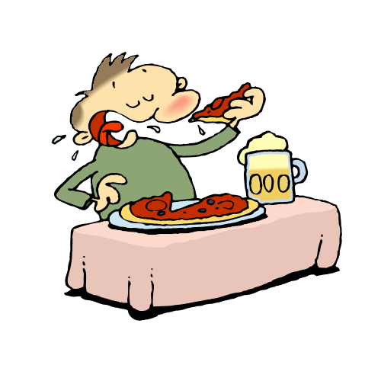
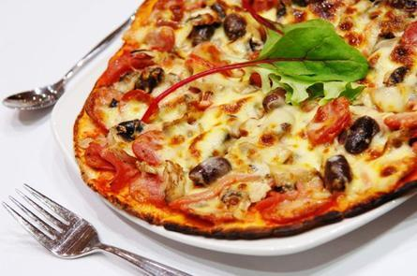
Pizza
Pizza is a meal of Italian descent path.
The first documented occurrence of pizza is dated around 1000 and around in a dialect of Italian Naples.
Raffaele Esposito baked three kinds of pizza, and in the national colors of Italy: with tomatoes, mozzarella and basil.

Slide 7
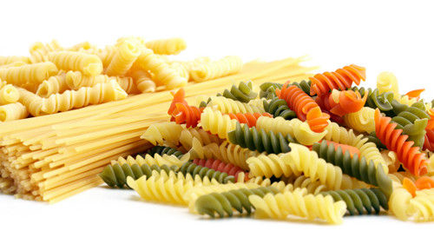
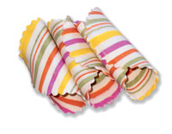
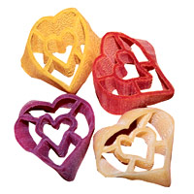
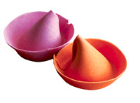
Pasta
Pasta is a food made ​​ from dough with flour, water and eggs.
Establishment of pasta is the time before Christ. The first mention comes from the Greek.
Called them laganon.
The first pasta is produced at home.
The first pasta factory began to emerge in the 17th century in Italy.

Slide 8
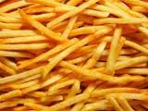
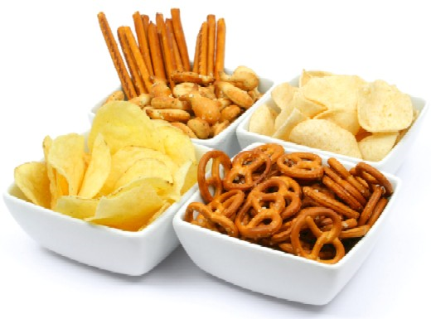
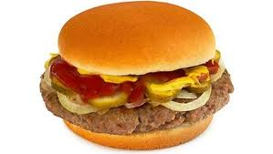
Teenegars food
Children often eat unhealthy food.
They are: chips, chocolate and little fruits and vegetables, hardly eat soup. They combine the wrong food.

Slide 9
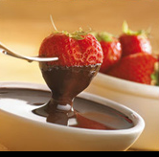
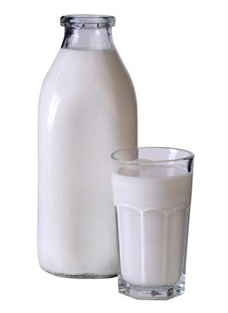
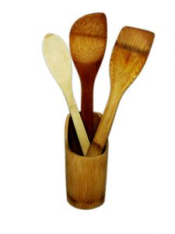
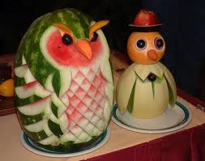
My food
I like many vegetables, fruit, meat and milk products( milk, yogurt, cheese,...).
I like also unhealthy food: chocolade, chips, hamburger, pizza,...
I know and cook a I enjoy it.
I like eat a lot.

Slide 10
Thank you

