Slide 1
Sports
Andrea Šidlová,
Martin Mokryš,
Jana Pavlusíková
9.A

Slide 2
Sport
A sport is an organized, competitive, entertaining, and skillful activity requiring commitment, strategy, and fair play, in which a winner can be defined by objective means.
Sports are most often played just for fun or for the simple fact that people need exercise to stay in good physical condition.

Slide 3
History of sport
There are artifacts and structures that suggest that the Chinese engaged in sporting activities as early as 4000 BC.
Gymnastics appears to have been a popular sport in China's ancient past. Monuments to the Pharaohs indicate that a number of sports, including swimming and fishing, were well-developed and regulated several thousands of years ago in ancient Egypt.

Slide 4
Youth sports
Participation in sports plays a large role in a child’s life.
The benefits of playing youth sports may include:
-Better grades
-Less risk of drug or alcohol use
-Chance at sports scholarships
-Health Benefits
The biggest risk for youth sports is the increased risk of injury, including concussions and gym class injuries.

Slide 5
Kinds of sports
Extreme sports
Motor sports
Gymnastics sports
Air sports
Combat Sports
Winter sports
Mentally sports

Slide 6
Sports Singles
* Athletics *Swimming
* Shooting *Driving
* Cycling *Skiing
* Gymnastics *Rowing
* Canoeing *Climbing
* Martial arts *Windsurfing
* Snowboarding *Badminton
* Modern Pentathlon *Fishing

Slide 7
Team sports
* Football * Rugby
* Floorball * Cricket
* Hockey * Water polo
* Basketball
* Baseball
* Handball
* Volleyball

Slide 8
Air sports
* Hang gliding
* Paragliding
* The flying balloons
* Motor flying

Slide 9
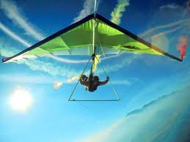
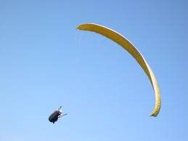
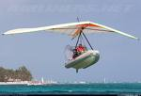
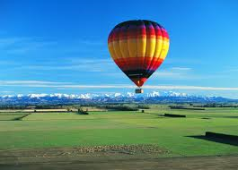
Air sports-pictures

Slide 10
Mentally sports
* chess
* go (game)
* snooker
* checkers game

Slide 11
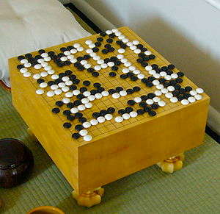
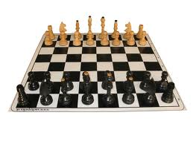
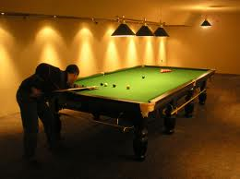
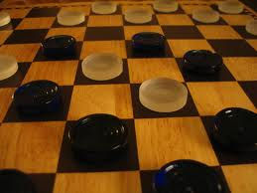
Mentally sports-pictures

Slide 12
Extreme sports
* Basejumping
* Le parkour
* Mountaineering
* Bungee jumping
* Landkiting
* Rodeo

Slide 13
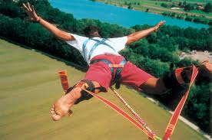
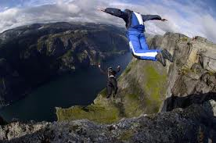
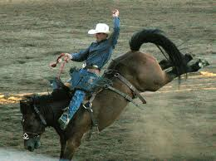
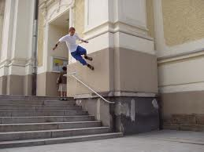
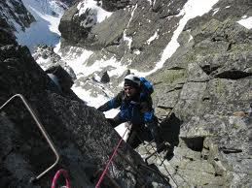
Extreme sports-pictures

Slide 14
Motor sports
* Formula 1
* Rally
* Minicars
* Hovercraft
* Snowmobiles
* Karts
* Motorcycle-motocross

Slide 15
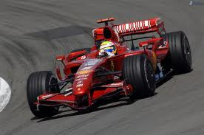
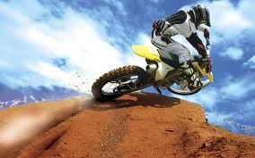
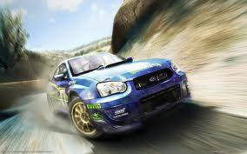
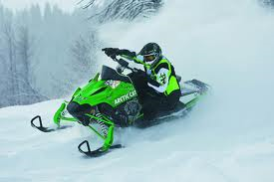
Motor sports-pictures

Slide 16
Gymnastics sports
* Skipping
* Parallel bars
* Floor exercise
* Circles
* Horse head

Slide 17
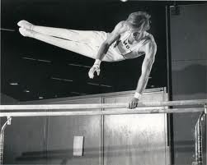
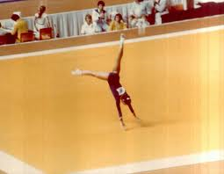
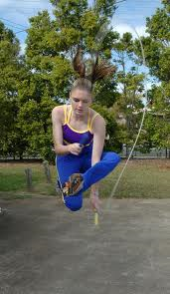
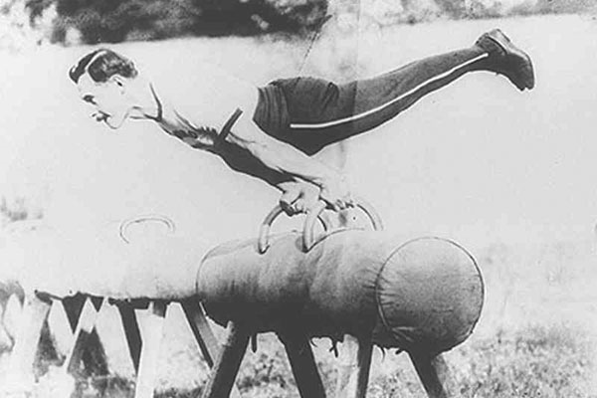
Gymnastics sports-pictures

Slide 18
Combat sports
* Wrestling
* Box
* Judo
* Karate
* Kickbox
* Sumo
* Fence

Slide 19
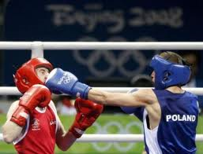
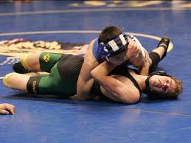
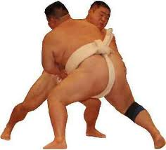
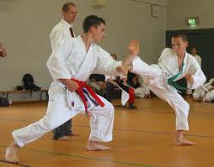
Combat sports-pictures

Slide 20
Winter sports
* Cross country skiing
* Figure skating
* Bobsleigh
* Skiing
* Snowboarding
* Ice hockey

Slide 21
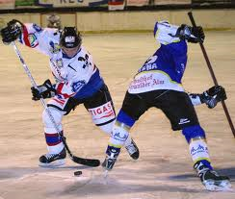
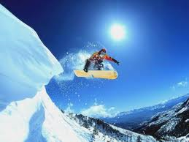
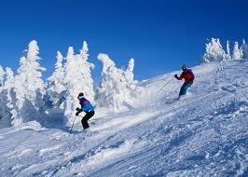
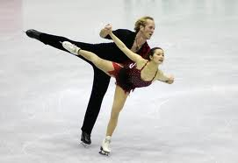
Winter sports-pictures

Slide 22
THE END
Thanks for watching!

